Slide 1
Local ambassador strategy pitch
Created by - VARAD

Slide 2
Ambassador Strategy Overview
Our strategy focuses on leveraging hyperlocal brand ambassadors to create authentic, community-driven engagement. By partnering with trusted local voices like Jordan Ellis, we aim to bridge the gap between national brand messaging and real neighborhood impact.
Why Hyperlocal Marketing Matters
Hyperlocal marketing builds stronger customer relationships by connecting with people where they live, train, and shop. It transforms broad campaigns into personal experiences, making the brand feel relatable, accessible, and relevant in each community.
How Local Ambassadors Drive Growth
Local ambassadors translate brand values into real-world action — hosting community events, creating relatable local content, and driving store visits through genuine, personal connections. Their credibility turns awareness into loyalty and engagement into measurable store traffic.

Slide 3
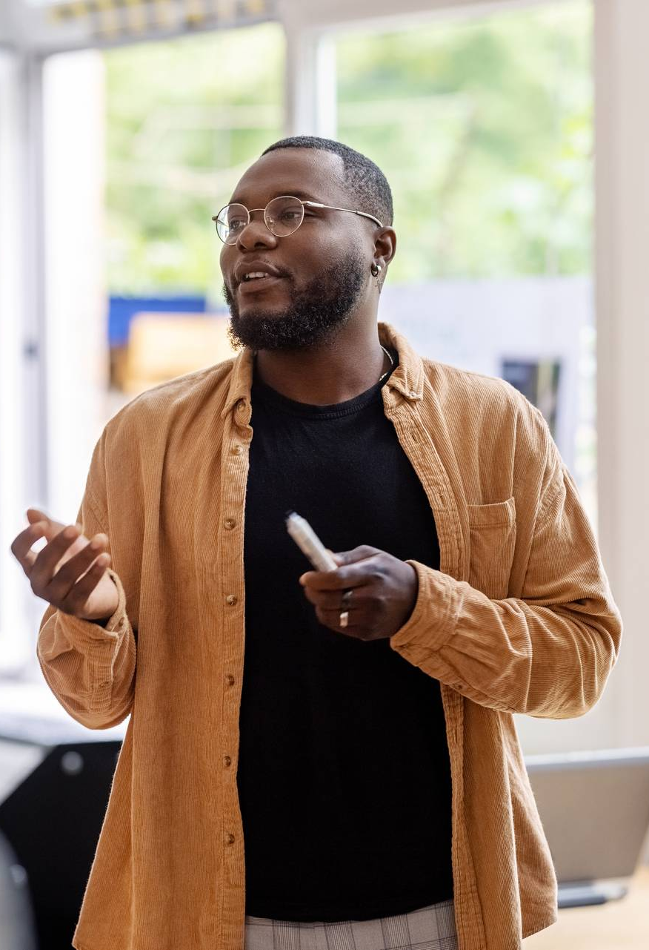
name: Jordan Ellis – Austin, TX
Profession: Track coach & wellness creator
Content: Fitness, mindfulness, and recovery tips
Audience: ~28K (ages 18–35), active and engaged local community
Brand Fit: Promotes inclusion, confidence, and well-being
Community Role: Hosts “Mindful Miles” runs & youth clinics
Store Impact: Leads “Train With Me” events and “Coach’s Picks” displays

Slide 4
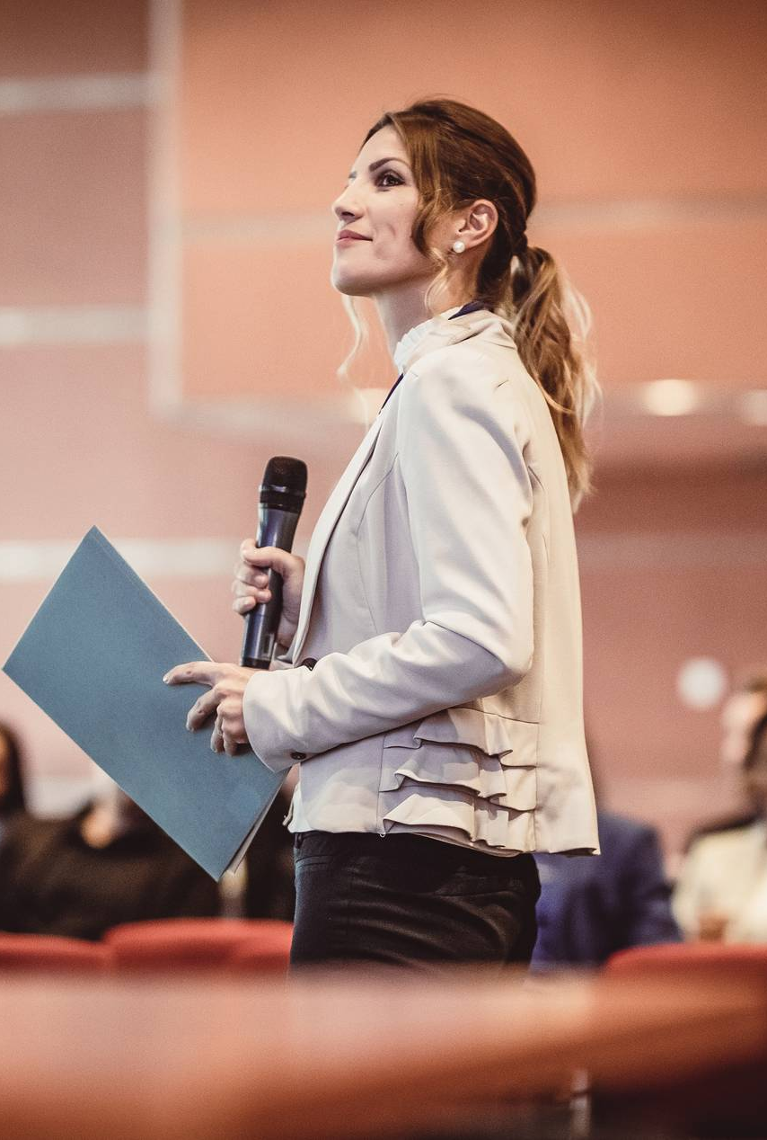
Name: Maya Thompson – Seattle, WA
Profession: Sustainable fashion blogger & content creator
Content: Showcases eco-friendly outfits, styling tips, and upcycling tutorials
Audience: ~35K followers (ages 20–40), conscious shoppers and young professionals interested in sustainability and style
Brand Fit: Advocates for responsible fashion, inclusivity, and creativity — aligning with the brand’s values of sustainability and self-expression
Community Role: Partners with local thrift shops for clothing drives, hosts weekend “Style Swap” events, and mentors college students on sustainable fashion
Store Impact:
Host in-store “Eco Edit” styling sessions.
Curate “Maya’s Sustainable Picks” product display.
Promote new conscious collection launches through authentic social content.

Slide 5
Local impact summary
Ambassador Strengths Comparison
Jordan Ellis (Austin, TX): Fitness-focused, community-driven, promotes wellness and performance.
Maya Thompson (Seattle, WA): Fashion-conscious, sustainability advocate, promotes creativity and responsible style.
Combined Impact on Brand Strategy
Together, they embody the brand’s values of well-being, inclusivity, and sustainability.
Their authentic voices connect with different local audiences—Jordan inspires active lifestyles, while Maya drives conscious fashion choices—creating a powerful, well-rounded hyperlocal presence.
Campaign Ideas & Store Activations
“Move & Style Weekend” Series: Fitness session with Jordan followed by sustainable styling workshops with Maya, linking wellness and fashion.
“Local Voices Spotlight”: Monthly in-store feature showcasing each ambassador’s curated picks, community stories, and exclusive product recommendations.

